Slide 1
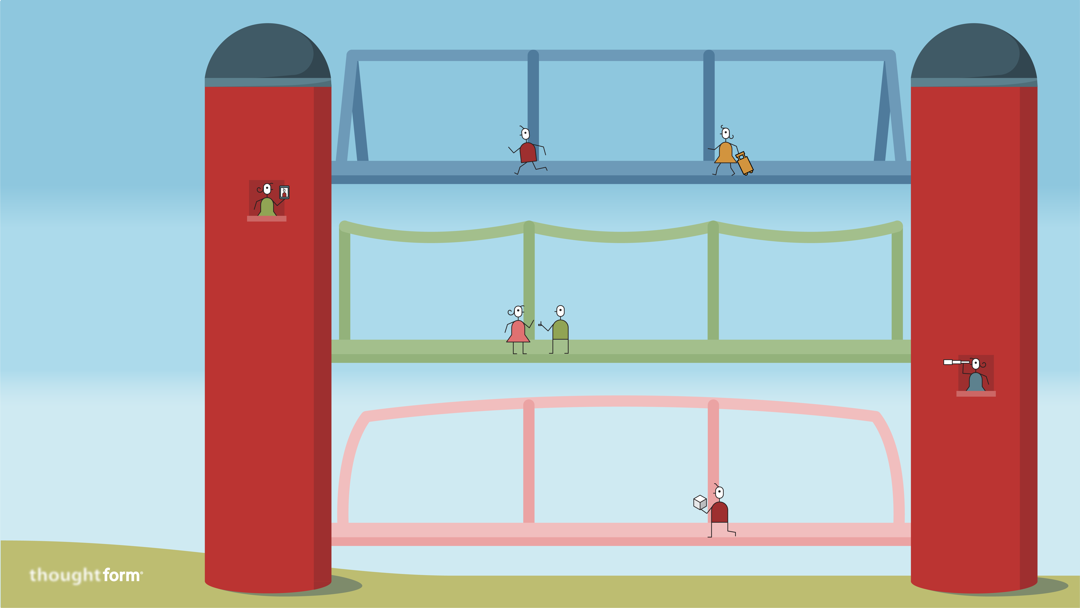
Bridging
Silos
CULTURE
Draft a team charter
that paints a shared picture of the result you plan to achieve and sets out ground rules for how you agree to work.
Maintain a meta-dialogue
among the team, focused on how your collaboration is going and what can be done to make it work better.
Build personal connections
that enable trust by taking time for team building, like icebreaker exercises and informal chats.
Your organization’s collective knowledge is a powerful tool to drive innovation, but it can be difficult to harness. That’s because knowledge often lives in separate operational teams, each with its own mental models and cultural norms. These “silos” can block effective collaboration. To bridge them, try a three-pronged approach that addresses culture, language, and methods. Here are nine practical tips that can help.
LANGUAGE
Define your terms
by identifying the principal components of your project and agreeing on the words that you will use to name them.
Trade elevator pitches with each other, explaining the components of the project that each of you are responsible for.
Require plain language so that fuzzy areas of the plan can’t hide behind jargon and acronyms. Be willing to say, “I don’t understand that.”
METHODS
Build a shared story
by working together to outline a step-by-step example of how the solution will work in practice.
Draw pictures to get each other on the same page about key aspects of your solution. For example, how will it create value for stakeholders?
Keep knowledge visible by developing your project with a digital whiteboarding tool like Miro that lets everybody follow the process and contribute.

